Slide 1
Trauma Packs for Massive Haemorrhage Protocol
Consultant/Lead Clinician decision to activate the protocol
e.g. Life threatening haemorrhage; trauma/ruptured AAA, obstetric haemorrhage
(ED Registrar can activate out of hours if they have contacted the on call consultant & inform the Haematologist at the earliest opportunity)
Send transfusion sample & FBC, COAG, UEs & LFT (if blood samples can be obtained). Completed request form is required whether or not bloods can be obtained
Ring: 24444 (between Mon-Fri: 09.00-17.00)
OR ring MOBEX: 46350 (Out of Hours)
Stating:
“I wish to activate the massive haemorrhage protocol”
Information Required:
Your name and contact number
Your precise location
Full identification details of patient
(Name, DOB, hospital number or unknown patient number)
Name of consultant triggering protocol
Use emergency Group O Red Cells available in Blood Bank or Theatre fridge
Trauma Pack 1 can be collected from Blood Bank 30 minutes after activating phone call
Trauma Pack 1 contains: 2 Red Cells & 2 units of FFP
(if additional Red Cells are required before Trauma Pack 1 is ready, contact Blood Bank)
ALWAYS CHECK BLOOD IS FOR THE RIGHT PATIENT
DO NOT OPEN THE BOX UNTIL BLOOD IS NEEDED
Following issue of Trauma Pack 1 the clinician must contact the Blood Bank if Trauma Pack 2 is required
Trauma Pack 2 can be collected 30 minutes after activating phone call
Trauma Pack 2 contains: 2 Red Cells, 2 FFP
Provision of platelets is to be discussed with blood bank
(universal donor or type specific if specimen available)
YOU MUST INFORM THE BLOOD BANK if Trauma Pack 2 or subsequent blood products are not required
(Stand Down)
It is the clinicians responsibility to contact the Blood Bank or Haematologist to discuss any other blood component requirements.
All unused blood components must be returned to the blood bank immediately
FOR FULL DETAILS PLEASE SEE POLICY C16 V14.2 LOCATED ON THE INTRANET
TRAUMA_PACK_MASSIVE_HAEMORRHAGE_PROTOCOL_V11 12/01/2022

Slide 2
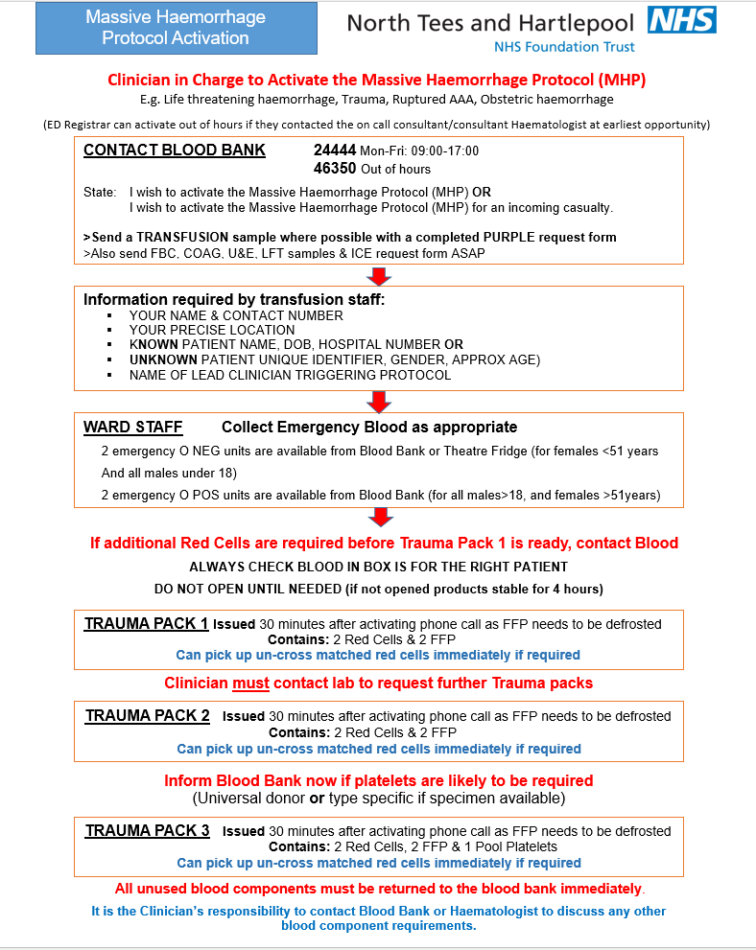

Slide 3
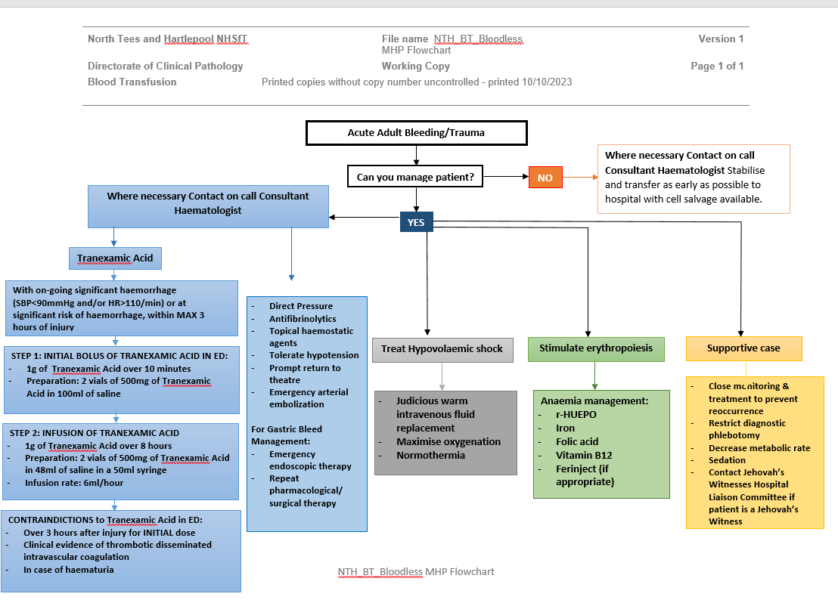

Slide 4
Paediatric Massive Haemorrhage Protocol Activation Flow Chart
Lead Clinician decision to activate the Paediatric Massive Haemorrhage Protocol (PHMP)
Signs of Hypovolaemic shock, Coagulopathy or Ongoing severe bleeding
(overt/covert) and received 20ml/kg of red cells or 40ml/kg colloid/crystalloid in preceding hour
Ensure a Consultant (ED or Paediatric Anaesthetist) is called to take charge
Activate Paediatric Massive Haemorrhage Protocol (PMHP)
Contact Blood Bank
Ring EXT: 24444 (Mon-Fri: 09.00-17.00)
or MOBEX: 46350 (out of hours) and state:
“I wish to activate the Paediatric Massive Haemorrhage Protocol (PMHP) for a patient less than (or more than) 20kg”
Telephone blood bank with child's age ,weight they will advise
Collect neonatal split from theatre fridge or blood bank/or Emergency O negative from blood bank
Send: XM, FBC, PT, APTT, Fibrinogen, UE, Ca²⁺, A(BG) samples
with completed request form to Laboratory
TEG not suitable for under 18’s
LAB Activate Trauma Pack 1
(within 30 minutes of activating call)
Administer up to:
Red Cells – 40ml/kg in 10ml aliquots
FFP – 20ml/kg
Total volume will depend on; weight, rate of blood loss, clinical signs and response
Once Trauma Pack 2 administered repeat bloods;
FBC, PT, APTT, Fibrinogen, UE Ca²⁺, (A) BG
To inform further blood component requesting
Reassess
Suspected continuing haemorrhage = further transfusion
Further bloods; FBC, PT, APTT, Fibrinogen, UE, CA²⁺, (A) BG
Order Trauma Pack 2:
Red Cells – 40ml/kg in 10ml aliquots
FFP – 20ml/kg
Platelets – 10ml/kg
CONSIDER INTUBATION IF >40ML/KG OF PRODUCTS GIVEN
Stand Down
Return unused components - Inform Lab - Complete Documentation
Weight | Red Cells | FFP | Platelets | *Cryoprecipitate
<20kg | 2 Adult suitable units (500ml) | 2 Paediatric units MB treated FFP (450ml) | 1 Adult apheresis pack (200ml) | 1 pool
>20kg | 4 Adult suitable units (1000ml) | 4 Paediatric units MB treated FFP (900ml) | 1 Adult apheresis pack (200ml) | 2 pools
*Cryoprecipitate 10ml/kg MB treated, Group A; issued if Fibrinogen <1g/l
A (BG): (Arterial) Blood Gas, APTT: Activated partial thromboplastin time, FFP: Fresh Frozen plasma, PT: Prothrombin Time, XM: Crossmatch
FOR FULL DETAILS PLEASE SEE POLICY C16 LOCATED ON THE INTRANET
MHP_ACTIVATION_FLOWCHART_PAEDIATRIC_V4_23/9/24

Slide 5
ORDERING BLOOD IN AN EMERGENCY
Appoint a qualified & experienced staff member to be a point of contact for communications.
Ring: Blood Bank on EXT: 24444 (Mon-Fri: 09.00-17.00)
or MOBEX: 46350 (out of hours)
Stating that an emergency transfusion is required and provide patient details, your location & contact number.
Contact on call Consultant Haematologist
Is there a G&S or baseline bloods in lab?
(FBC, Coag, U&Es, LFT)
NO
Consultant Haematologist to contact Blood Bank with any instructions
YES
Take sample for G&S and baseline bloods (FBC, Coag, U&Es, LFT)
Request blood depending on degree of urgency.
All requests need a request form with all patient details sent to Blood Bank
stating how many Red Cells are required
BMS can issue FFP ratio 1:1
Emergency Group O
Group Specific
Full Serological
Cross-Match
5 minutes to issue. Uncross-Matched at time of issue so risk of incompatibility – Doctors responsibility to accept risk
10-15 minutes to issue from receipt of sample. Same group as patient but not cross-matched at time of issue – Doctors responsibility to accept risk
45 minutes from receipt of sample.
Cross-Matched
For continued blood loss – refer to Massive Haemorrhage Protocol (MHP).
It is the Clinicians decision to active protocol and Blood Bank must be kept informed
Keep in contact with Blood Bank and the Consultant Haematologist to discuss further blood component requirements
Platelets
Cryoprecipitate
Other products
e.g. Tranexamic acid
FOR FULL DETAILS PLEASE SEE POLICY C16 V14.2 LOCATED ON THE INTRANET
EMERGENCY_BLOOD_FLOWCHART_V7 12/01/2022

Slide 6
Tranexamic Acid in Trauma in the Emergency Department
KEY POINT: Early administration (within 3 hours of injury) of Tranexamic Acid (TXA) (antifribinolytic agent) in bleeding trauma patient significantly reduces death due to bleeding
(CRASH 2 study – Lancet 2010; 376:23-32 and Lancet 2011; 377: 1096-1101)
Adult Trauma Patient – Penetrative & Blunt Trauma
With on going significant haemorrhage (SBP<90mmHg and/or HR>110/min)
At risk of significant haemorrhage
Within MAX 3 hours of injury
STEP 1: INITIAL BOLUS OF TRANEXAMIC ACID IN ED:
1g of Tranexamic Acid over 10 minutes
Preparation: 2 vials of 500mg of Tranexamic Acid in 100ml of saline
STEP 2: INFUSION OF TRANEXAMIC ACID
1g of Tranexamic Acid over 8 hours
Preparation: 2 vials of 500mg of Tranexamic Acid in 48ml of saline in a 50ml syringe
Infusion rate: 6ml/hour
CONTRAINDICTIONS to Tranexamic Acid in ED:
Over 3 hours after injury for INITIAL dose
Clinical evidence of thrombotic disseminated intravascular coagulation
Tranexamic_Acid_Flowchart_V3 12/01/2022

